Slide 1
APPLIED PHYSICS
(SEAP-113)

Slide 2
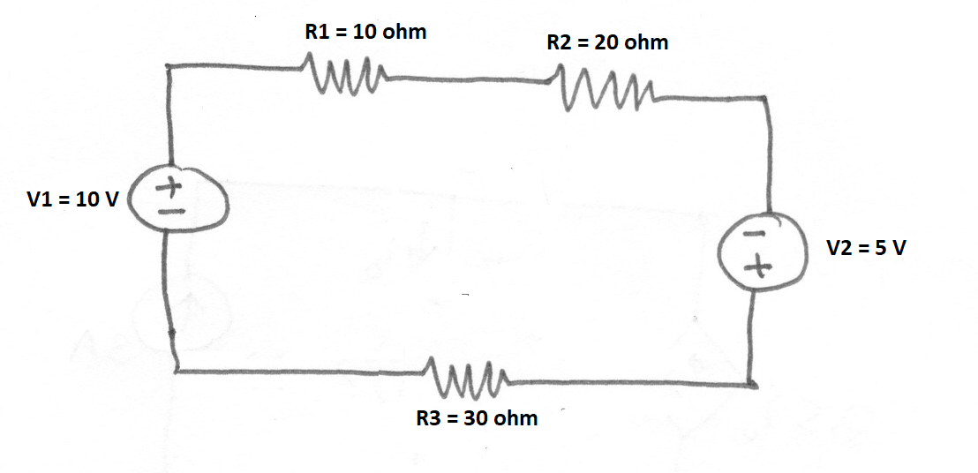
Quiz No. 2
Find the Power dissipated across each resistor in the circuit.

Slide 3
AC vs DC
Definition: Alternating Current (AC) is a type of electrical current, in which the direction of the flow of electrons switches back and forth at regular intervals or cycles. Current flowing in power lines and normal household electricity that comes from a wall outlet is alternating current.
The values of voltage and the current system in a DC circuit is constant, so there is no issue in evaluating their magnitudes, but in an AC system, the alternating voltage and current vary from time to time and hence it is necessary to evaluate their magnitudes.
The following 4 ways (peak value, peak to peak value, Average value and R.M.S value) given below are adopted to express the magnitude of the voltage and current.
Peak Value
Peak to Peak Value
Average Value
Root Mean Square Value (RMS) or Effective Value

Slide 4
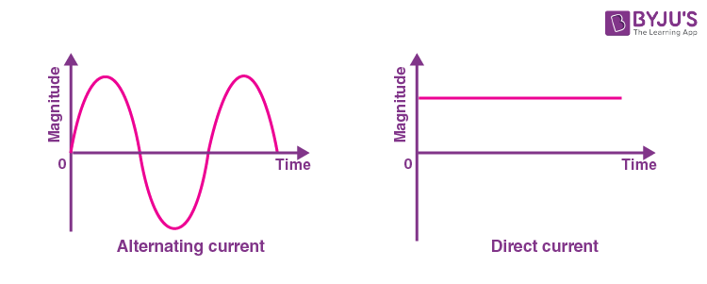
AC vs DC

Slide 5
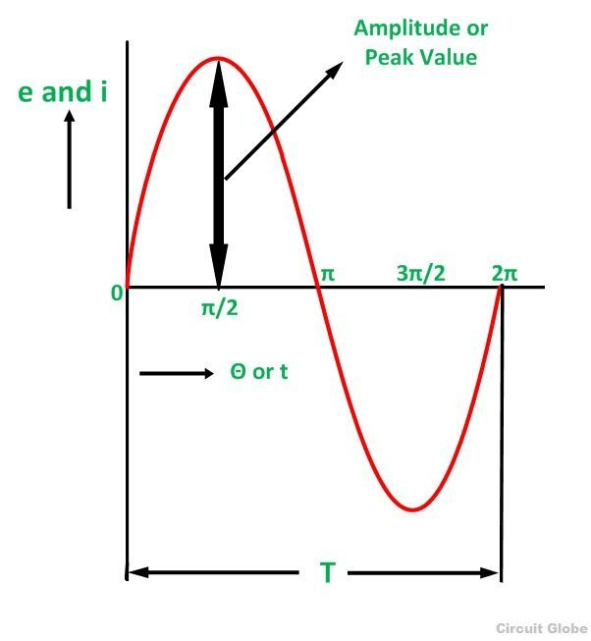
Peak Value of AC
Peak Value
The maximum value attained by an alternating quantity during one cycle is called its Peak value. It is also known as the maximum value or amplitude or crest value. The sinusoidal alternating quantity obtains its peak value at 90 degrees or pi/2 time stamp.
The peak values of alternating voltage and current is represented by Em and Im respectively.
Peak-to-peak (pk-pk) is the difference between the highest and the lowest values in a waveform.

Slide 6
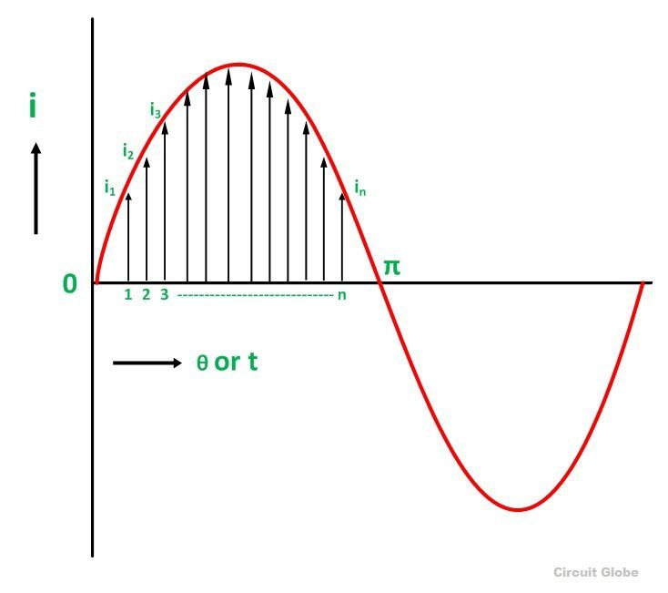
Average Value of AC
Definition: The average of all the instantaneous values of an alternating voltage and currents over one complete cycle is called Average Value.
If we consider symmetrical waves like sinusoidal current or voltage waveform, the positive half cycle will be exactly equal to the negative half cycle. Therefore, the average value over a complete cycle will be zero.

Slide 7
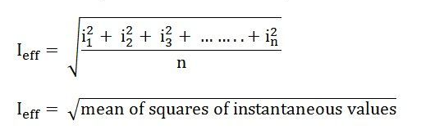
Root Mean Square Value or Effective Value
R.M.S value is defined as the square root of means of squares of instantaneous values.
Root Mean Square is the actual value of an alternating quantity which tells us an energy transfer capability of an AC source.
The ammeter records the RMS value of alternating current and voltmeter record’s the root mean square (R.M.S) value of alternating voltage. The domestic single-phase AC supply is 230 V, 50 hertz, where 230 V is the R.M.S value of alternating voltage.

Slide 8
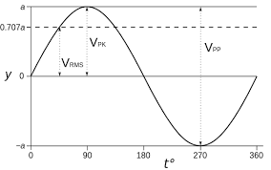

Slide 9
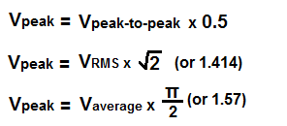
Formulas for conversion

Slide 10
Rectifier
A rectifier is an electrical component that converts alternating current (AC) to direct current (DC). A rectifier is analogous to a one-way valve that allows an electrical current to flow in only one direction. The process of converting AC current to DC current is known as rectification.
Many electronic circuits use DC voltage for operation. We can easily convert AC voltage or current into DC voltage or current by using a device known as a p-n junction diode. A p-n junction diode allows electric current to flow in forward bias condition and blocks the current in reverse bias condition. Simply, a diode allows electric current to flow in one direction only. This unique property of diode allows it to act as a rectifier.

Slide 11
Common Applications of Rectifiers
Some common applications of rectifiers are:
Rectifiers are used in electric welding to provide polarized voltage
Half-wave rectifiers are used as a mosquito repellent
Half-wave rectifiers are used as a signal peak detector in AM radio
Rectifiers are used in modulation, demodulation and voltage multipliers

Slide 12
Half Wave Rectifier
Diodes are mainly used in the power supply circuits
Power supply converts the standard 230V AC to some DC voltage level
Main part of a dc supply is the rectifier
There are two types of rectifiers
Half wave rectifier
Full wave rectifier

Slide 13
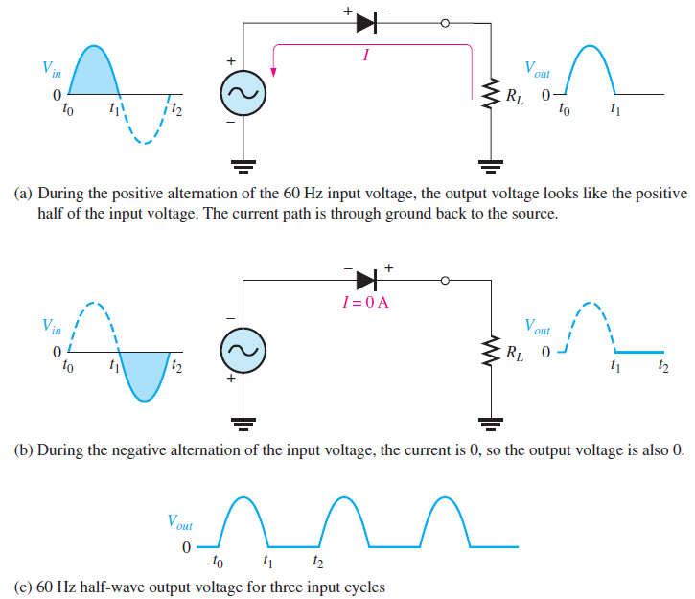
Half Wave Rectifier (contd.)

Slide 14
Half Wave Rectifier (contd.)
During the positive cycle diode conducts and current flow through the resistor
For a negative cycle, diode goes into reverse biasing and do not operate, no current flows through resistor
Net result is that only positive cycle of AC source appears across load resistor
No polarity change at the output so a pulsating dc voltage appears across diode
Frequency of Input and Output remain same.

Slide 15

Half Wave Rectifier (contd.)
Average value of half wave output voltage can be calculated as:
$$V_{Avg}=\frac{{2V}_{P}}{π}$$
Equation shows that V_{avg} is approx. 31.8% of V_{p} (Ideal Diode Case)
When a practical model is used peak output voltage can be calculated as:
$$V_{P(out)}=V_{P(in)}−0.7V$$

